Slide 1
Payment Inequality in Men and Women
Name of Student
Name of Institution
Course Name

Slide 2
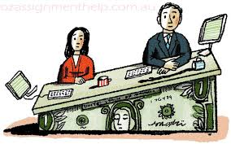
Gender wages Inequality

Slide 3

Conduct a Pay Audit
The first step to take when addressing this problem is awareness.
It is important to note that compensation should be done regardless of gender or race so as to deal with the issue of pay gaps.
It is also in order to be open on how your organization decides compensation so that the employees don’t have to guess the highlights that determine their pay.

Slide 4

Fair Job Promotions
Make sure that promotions are done conducted are done in a fair manner.
The promotions and reviews of audit ensure that the company is rating workers in both gender equally and not favoring men by rating them highly.
Workers in the company should be promoted at the same rate. The managers should be trained and made to understand the effects of gender bias on their decision making process and state clear procedures to minimize and fight bias in the review of performance.

Slide 5
Personal Development Opportunities
Ensure women have equal chances for advancing.
Women are typically given less or no feedback on the performance of their duties and they have very little or no access to mentorship.
Men have got greater access to mentorship and sometimes sponsorship.
The company should ensure that women in that company are able to access people and opportunities that will facilitate careers and are given equal amount of office work as men.
For example in the organization of events women should be given equal opportunities so that they can have an access to opportunities.

Slide 6
Equal Negotiation Opportunities
Make it a good thing for women to negotiate.
There is a notion that women are collaborative and giving and we tend to see them as people who don’t deserve anything good.
This social challenge can affect the outcome of women’s negotiation in a bad way and also negatively affect their careers and future occupations.
We should encourage women in our organizations to form negotiation platforms and we should not punish them but to applause them.

